Slide 1

RaspberryPi --- CS 442/642 Cybersecurity in the Internet of Things
Lecturer: Dr. Xiaohui Liang
Office: M-3-201-24
Phone: 617-287-6791
Email: Xiaohui.Liang@umb.edu

Slide 2
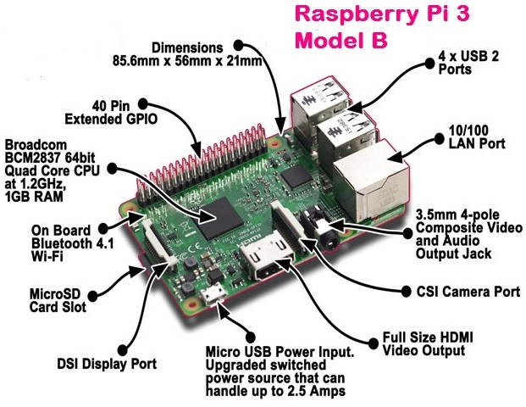
What is a Raspberry Pi?
University of Cambridge’s Computer Laboratory
Designed for education
A credit card sized PC
Plugs into a TV or monitor
Inexpensive ~$35 each
Capability:
Programming
Electronic Projects
Office
Play HD Videos

Slide 3
What You Need
Essential:
Raspberry Pi board
Prepared Operating System SD Card
USB keyboard
Display (with HDMI, DVI, or Composite input)
Power Supply

Slide 4
Hardware Components

Slide 5
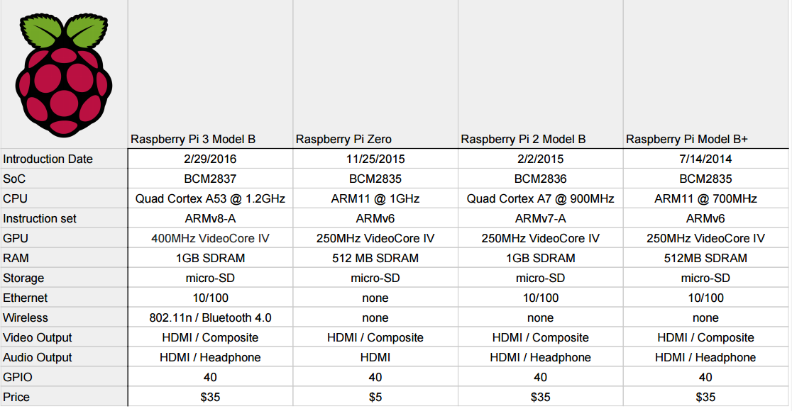
Spec – Comparison w/ older versions
Our Model

Slide 6
System on Chip
Broadcom BCM2837 system-on-chip (SoC)
Built specifically for the new Pi 3
Four ARM Cortex-A53 cores @ 1.2GHz

Slide 7
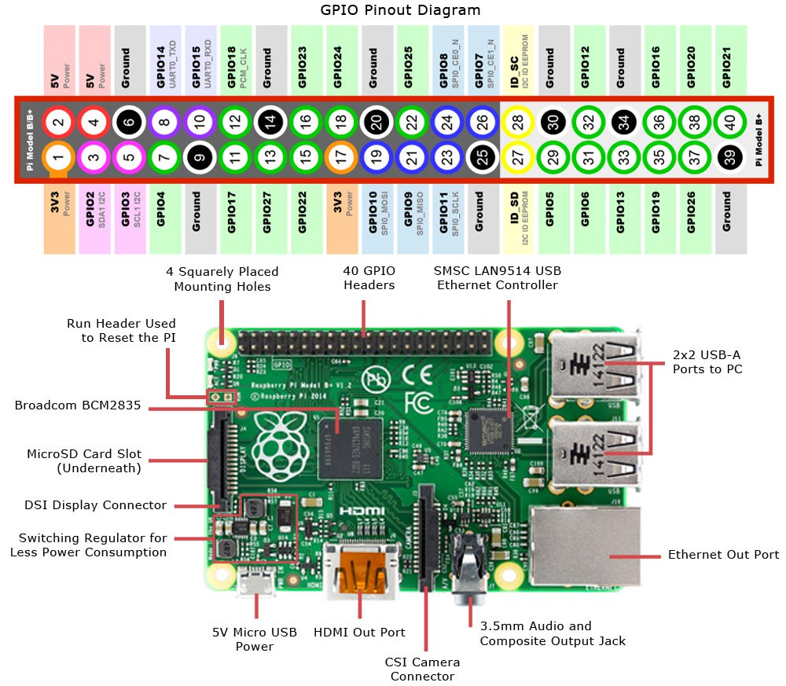
GPIO
40-pin general-purpose input-output (GPIO)

Slide 8
Antenna
No need to connect an external antenna
For both wireless LAN and Bluetooth signals

Slide 9
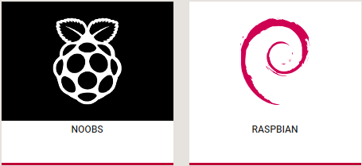


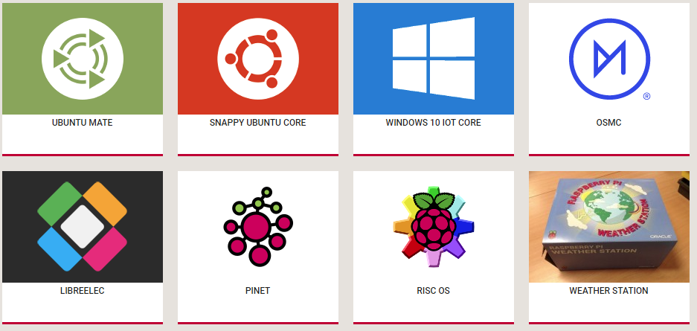
Operating System
Multitude of OSs work with Pi:

Slide 10
Raspbian
Official supported Operating System
Debian based (like Ubuntu!)
Two versions:
RASPBIAN STRETCH WITH DESKTOP (with GUI)
RASPBIAN STRETCH LITE (only Terminal)

Slide 11
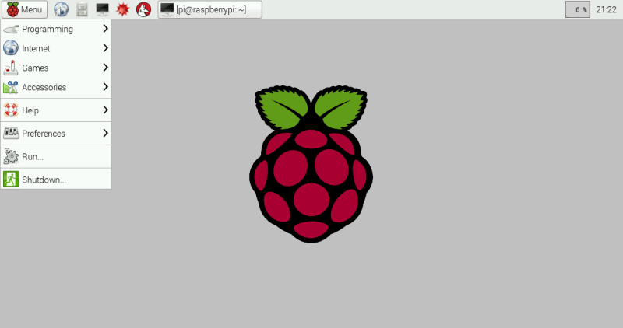
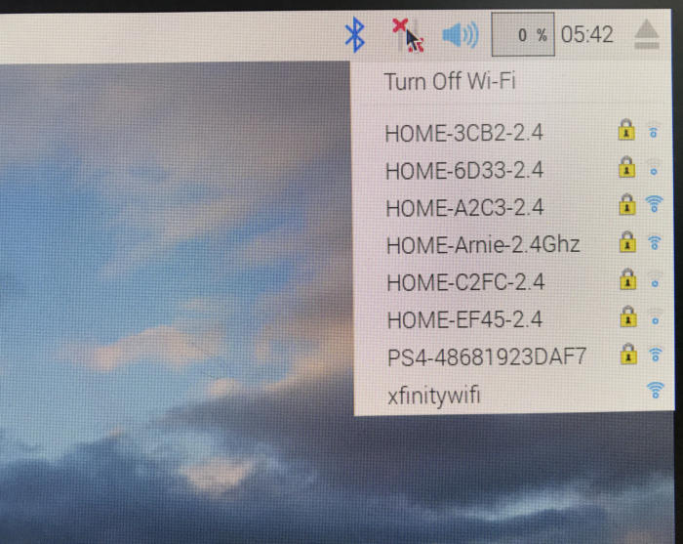
Raspbian Desktop
Full Desktop with keyboard, mouse, monitor, etc. support

Slide 12
Programming Languages
The Raspberry Pi Foundation recommends Python
Other supported language
C
C++
Java
Scratch
Ruby

Slide 13

Software
Office

Slide 14


Software
Programming

Slide 15
Raspberry Pi Setup
Installing the OS
Downloading the Raspbian Desktop image: https://www.raspberrypi.org/downloads/raspbian/
Raspbian Buster with desktop and recommended software
Or Raspbian Buster with desktop
(Optional) Formatting the SD card if it is larger than 32 GB.
https://www.sdcard.org/downloads/formatter/
Burning the image on the micro SD card (FAT32)
https://etcher.io/
Connection to the internet
Dynamic IP (default)
Static IP
sudo nano /etc/dhcpcd.conf.
Type in the following lines on the top of the file: interface eth0 staticip_address=192.168.1.XX/24 static routers=192.168.1.1 staticdomain_name_servers=192.168.1.1.
sudo reboot.
Notes:
Slide: 2min
Demo: 6-7min

Slide 16
Raspberry Pi Setup
SSH Accessibility
Needed to remotely work on the Pi
Needed to remove the requirement of keyboard, mouse and monitor
By default disabled in Raspberry Pi
Default username and password on Pi: “pi” and “raspberry”
To enable SSH by default
Pi configuration: sudo raspi-config >>Interfacing Options >> SSH
Manual: placing a file “ssh” on the boot partition of the SD card
To enable VNC
Find IP address
Pi configuration: sudo raspi-config >>Interfacing Options >> VNC
Notes:
2min
3min

Slide 17
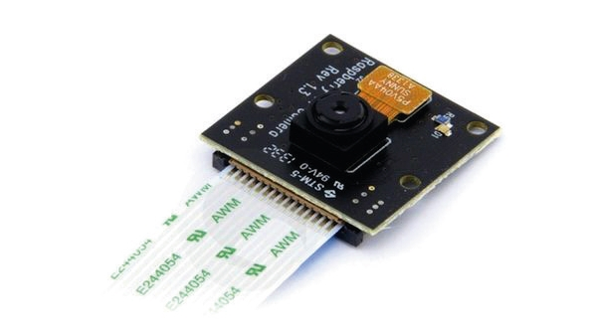
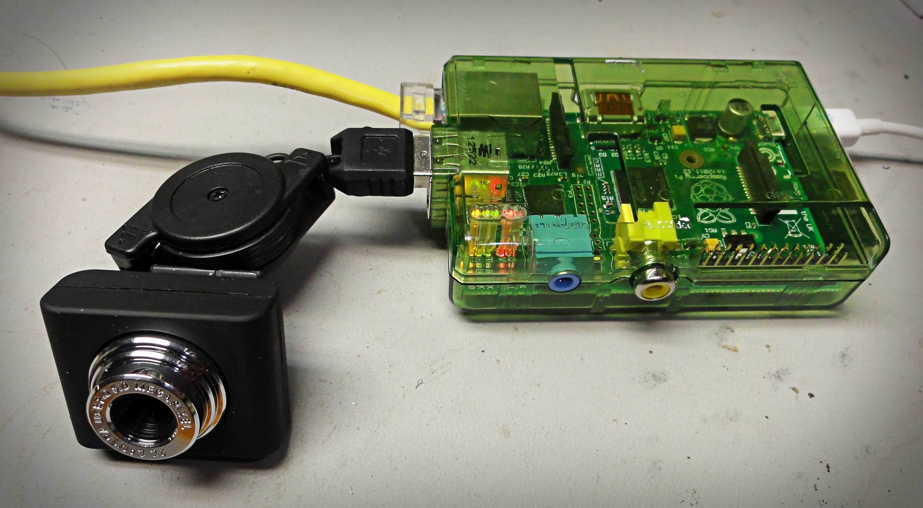
Use case
IoT Home Component!
Example: Home surveillance system

Slide 18
Use cases
Temperature And Humidity Sensor
Farmbot *
Kindbot: Smart Home Gardening
Automatic Vision Object Tracking
Home security and ip camera
Smart Traffic Light
Supercomputer
Anomaly Detection in Home-Area Networks using Machine Learning and Raspberry Pi
Raspberry Pi Microwave *
3D Scanner
Windows IoT smart door

